Slide 1
The Twelve Core Action Values
Created by Joe Tye, CEO and Head Coach Values Coach Inc.
Copyright © 2010, Values Coach Inc.

Slide 2
“If we each do our part, we will change our lives for the better. If we all do our parts, we will change our organizations for the better.”
The Florence Prescription

Slide 3
“And in changing our organizations, we can change our world for the better.”

Slide 4
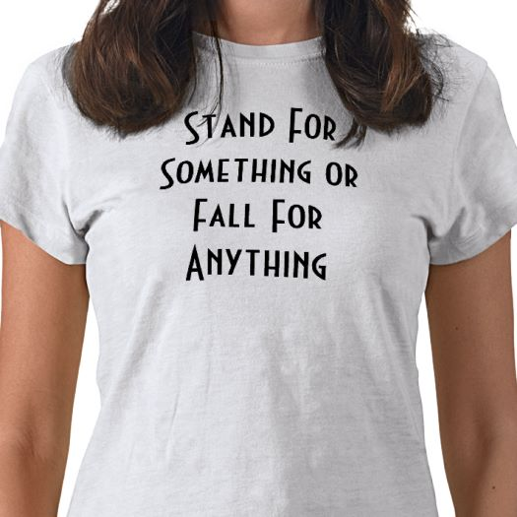
Core values define what you stand for and what you won’t stand for

Slide 5
A core value is a deeply held personal philosophy that guides how you think, how you set goals and priorities, how you make decisions, how you build relationships, and how you manage conflict.

Slide 6
Organizational values determine how you select, train, and retain people; how you treat customers and each other; how you manage resources; and how you serve your community.

Slide 7
The deepest human values transcend political and religious beliefs, ethnic heritage, social class, and every other superficiality.

Slide 8
The guiding insight behind our work at Values Coach…
Notes:
These are values of how we treat others, values of how we treat ourselves. Found most people really have never sat down and really thought through, “what are my values?” How would I make a choice between Honesty and Loyalty for example…

Slide 9
Values are Skills

Slide 10
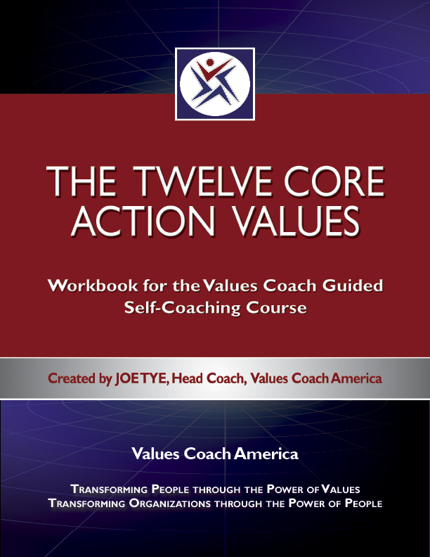
Don’t sell your people or your organization short:
Because nobody learns everything they need to know in kindergarten!

Slide 12
Core Action Values 1-6: Laying a Solid Foundation

Slide 13
Core Action Value #1
Authenticity

Slide 14
The greatest triumph of the human spirit is to become the unique and special person you were meant to be; the greatest tragedy is to live your life pretending to be someone else.

Slide 15
After all, who wants to be a phony?
Core Action Value #1 is Authenticity

Slide 17
“We come into this world with a specific, personal destiny. We have a job to do, a calling to enact, a self to become. We are who we are from the cradle, and we’re stuck with it. Our job in this lifetime is not to shape ourselves into some ideal we imagine we ought to be, but to find out who we already are and become it.”
Steven Pressfield: The War of Art

Slide 18
What would you do if every job paid the same and had the same social status? And why aren’t you doing that now?

Slide 19
Cornerstone #1
Self-Awareness
Use internal observation and external feedback to uncover your truest strengths and passions and the “meant to be” you.

Slide 20
Cornerstone #2
Self-Mastery
Stay out of the Iron Triangle of False Personality – manage your emotions, keep your ego out of the way, and pursue only authentic ambitions.

Slide 21
Cornerstone #3
Self-Belief
Work to strengthen each level of the Pyramid of Self-Belief:
Self-Concept
Self-Image
Self-Awareness
Self-Confidence

Slide 22
Cornerstone #4
Self-Truth
Use Direction Deflection Questions to guide your attitudes and your actions in a way that moves you closer to your best self in every dimension of your life.

Slide 23
Core Action Value #2
Integrity

Slide 24
Trust is not a value – trust is an outcome: you earn trust by acting upon the four cornerstones of Integrity.

Slide 25
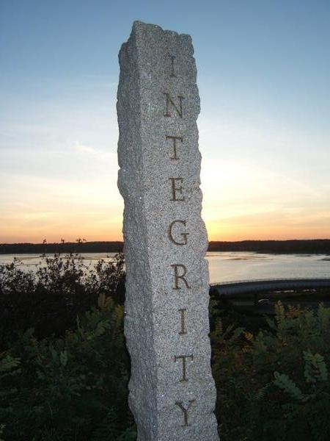
Without integrity, short-term winners inevitably become long-term losers. Integrity is the foundation of trust and respect.

Slide 26
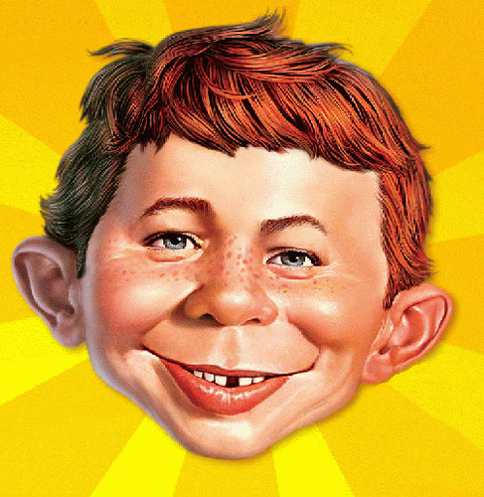
The Integrity Gap

Slide 28
“Integrity means being whole, unbroken, undivided. It describes a person who has united the different parts of his or her personality, so there is no longer a split in the soul… For the person of integrity, life may not be easy but it is simple: Figure out what is right and do it. All other considerations come in second.”
Harold Kushner: Living a Life That Matters

Slide 29
Cornerstone #1
Honesty
Be absolutely honest – especially with yourself. Genuine honesty is more than just not telling lies – it is living the truth.

Slide 30
Cornerstone #2
Reliability
Do what you say you’re going to do, when you say you’re going to do it, and do it to the best of your ability.

Slide 31
Cornerstone #3
Humility
Virtually every failure of integrity begins with arrogance on the part of those responsible; humility is an essential ingredient of effective leadership.

Slide 32
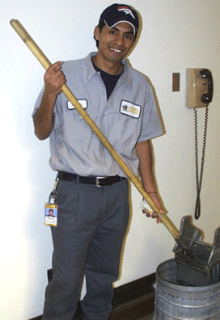
The root of the word integrity is “integer” – one unified whole
Carlos…
The incredible invisible man

Slide 33
Cornerstone #4
Stewardship
Honor the obligation to be a good steward of your own resources, the resources of your organization, and of the fragile world in which we live.

Slide 34
Core Action Value #3
Awareness

Slide 35
If you’re not enjoying the journey, the destination will be a disappointment. Awareness is the ultimate essence of emotional intelligence.

Slide 36
“To be in the world but not of it means to experience as many things as possible but not to get bogged down or attached to troubles that might impede our human journey… Traveling light isn’t just good advice, it’s essential wisdom.”
Brian Luke Seaward: Quiet Mind, Fearless Heart

Slide 37
Cornerstone #1
Mindfulness
Inner awareness underlies “the miracle of mindfulness” and “the peace of God that passes all understanding” and other references to inner peace from the world’s greatest scriptural literature.

Slide 38
Cornerstone #2
Objectivity
See the world as it really is, not as it used to be, as you wish it were, or as you fear it might become.

Slide 39
Cornerstone #3
Empathy
The ability to read another person’s emotions, and to put yourself into their shoes rather than simply reacting out of your own emotions, is the highest form of emotional intelligence.

Slide 40
Cornerstone #4
Reflection
Be sure to make time for yourself - for asking yourself the important questions, and for observing the dominating patterns in your life.

Slide 41
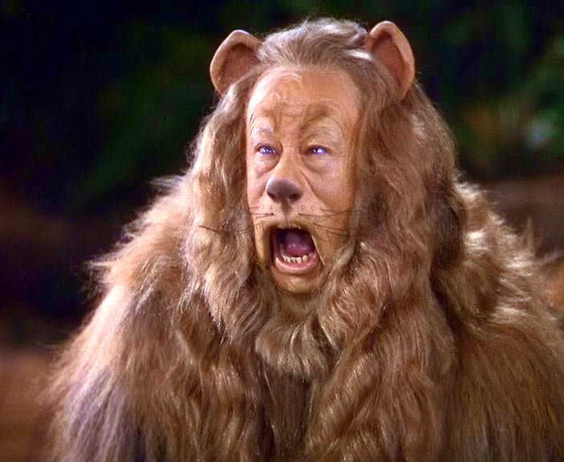
Core Action Value #4
Courage

Slide 42
Fear is a natural, hardwired human emotion. You cannot conquer fear; you cannot drive it out of the workplace. The secret is to make fear your ally and not allow it to be your enemy.

Slide 43
“Even when we face down our fears – and you would be amazed how often we succeed in doing precisely that – we are still more conscious of our cowardice than of our courage. We feel the fear over which we triumph at the very moment of triumph itself, yet rarely do we actually feel courage. We rally to it's call, but we don't feel it. What courageous people feel is fear... We feel frightened and demonstrate courage.”
Forrest Church: Freedom from Fear

Slide 44
Cornerstone #1
Confrontation
Distinguish between anxiety, fear and worry. Give fear a name and it becomes just a problem; it’s easier to solve problems than it is to conquer fear.

Slide 45
Cornerstone #2
Transformation
The symptoms of terror and exhilaration are identical; it’s the interpretation that makes the difference: does fear paralyze you or does it catalyze you?

Slide 46
Cornerstone #3
Action
Fear is a cowardly emotion; it retreats in the face of determined action. Action transforms fear from emotional molasses to emotional jet fuel.

Slide 47
Cornerstone #4
Connection
Fears shrink when confronted by friends. As anyone who has ever participated in a support group knows, a sense of being connected with others is a powerful antidote to anxiety, fear and worry.

Slide 48
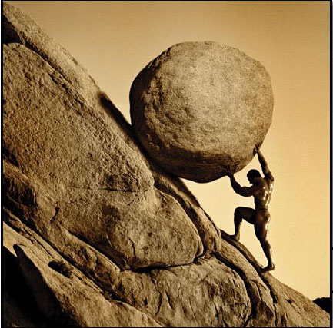
Core Action Value #5
Perseverance

Slide 49
Every great accomplishment was once the “impossible” dream of a dreamer who simply refused to quit when the going got tough.
If courage is a decision, perseverance is making that decision day after day after day.

Slide 50
“Persistence is probably the single most common quality of high achievers. They simply refuse to give up. The longer you hang in there, the greater the chance that something will happen in your favor. No matter how hard it seems, the longer you persist the more likely your success.”
Jack Canfield: The Success Principles

Slide 51
Cornerstone #1
Preparation
Adversity can be anticipated in general but not in specific, so prepare the way a fire department trains - getting ready for whatever might happen.

Slide 52
Cornerstone #2
Perspective
Whether it is the best of times or the worst of times depends have upon what you choose to see. Choose to a positive perspective.

Slide 53
Cornerstone #3
Toughness
Internalize a spirit of contrarian toughness by internalizing the TGAoT (Thank God Ahead of Time) philosophy for dealing with adversity by seeking blessings in its wake rather than acting out resentment.

Slide 54
Cornerstone #4
Learning
Life’s most important lessons, greatest opportunities, and most cherished friendships are most often formed during times of adversity.

Slide 55
Core Action Value #6
Faith

Slide 56
Throughout history, faith has been a powerful source of strength and solace for humans, a power that transcends specific religious beliefs and practices (or their absence). Faith begins at the point where certainty ends.

Slide 57
“People don’t want more information. They are up to their eyeballs in information. They want faith – faith in you, your goals, your success, in a story you tell. It is faith that moves mountains, not facts. Facts do not give birth to faith. Faith needs a story to sustain it – a meaningful story that inspires belief in you and renews hope that your ideas indeed offer what you promise.”
Annette Simmons: The Story Factor

Slide 58
Cornerstone #1
Gratitude
Complaining is the anti-prayer - whining about blessings that have not (at least not yet) showed up rather than being thankful for those blessings that are around you at all times.

Slide 59
Cornerstone #2
Forgiveness
The real beneficiary of forgiveness is not the one who is being forgiven, it’s the one who is doing the forgiving.

Slide 60
Cornerstone #3
Love
The Beatles were right: there’s nothing you can do that can’t be done and there’s no one you can save that can’t be saved - all you need is love (but love is not a mushy emotion – it’s hard work)

Slide 61
Cornerstone #4
Spirituality
People who really do believe that whoever dies with the most toys wins end up being the biggest losers in life.

Slide 62
Core Action Values 7-12: Taking Effective Action

Slide 63
Core Action Value #7
Purpose

Slide 64
Someone with a job is never secure; someone with a calling is never unemployed. The work a person chooses to do, and how they choose to do it, is a key determinant of who they become.

Slide 65
“Purpose is that deepest dimension within us — our central core or essence — where we have a profound sense of who we are, where we came from, and where we’re going. Purpose is the quality we choose to shape our lives around. Purpose is a source of energy and direction.”
Richard Leider: The Power of Purpose

Slide 66
Cornerstone #1
Aspiration
Purposeful people aspire to work that gives them a personal sense of meaning, and to making their corner of the world a better place.

Slide 67
Cornerstone #2
Intentionality
Positive thinking is planning and working to achieve your goals; wishful thinking is hoping and waiting for someone else to make it happen.

Slide 68
Cornerstone #3
Selflessness
People inspired with a sense of purpose rise above “what’s in it for me?” thinking and commit themselves to a larger good.

Slide 69
Cornerstone #4
Balance
Purpose as a value means being purposeful in every dimension of life, not just in the work you do – also family, community, hobbies, and personal growth.

Slide 70
Core Action Value #8
Vision

Slide 71
Humans are the only creature that can see something in the mind’s eye that is invisible to the outside world. Cherish this God-given gift - cultivate it, use it to create your ideal future.

Slide 72
“Vision is the best manifestation of creative imagination and the primary motivation of human action. It’s the ability to see beyond our present reality, to create, to invent what does not yet exist, to become what we not yet are. It gives us capacity to live out of our imagination instead of our memory.”
Stephen R. Covey, A. Roger Merrill, and Rebecca R. Merrill: First Things First

Slide 73
Cornerstone #1
Attention
What you choose to give your attention to will create the platform upon which you create your future vision - choose wisely.

Slide 74
Cornerstone #2
Imagination
Visualization is the verb that precedes the noun of vision; don’t abuse your imagination with fantasy and worry; rather use it to create memories of the future.

Slide 75
Cornerstone #3
Articulation
Before it can become reality, a vision must be articulated in such a way as to inspire passion and confidence in those who must bring it about.

Slide 76
Cornerstone #4
Belief
Belief is a force of nature, and it is a force multiplier. All achievement begins in the mind of someone who believes in the possibilities.

Slide 77
Core Action Value #9
Focus

Slide 78
The One Big YES requires lots of little No’s. Focus is an essential ingredient for effectiveness, whether in your career or hobbies, your financial situation, or your personal happiness.

Slide 79
“I don’t think most people realize how stressful it can be to have multiple incomplete tasks hanging over your head… This is an easy habit to break. Take an honest look at your own tendencies. If you are someone who often almost finishes something, take note of the tendency and commit yourself to that last final completion. You can do it – and when you do, your life is going to seem so much easier.”
Richard Carlson: Don’t Sweat the Small Stuff at Work

Slide 80
Cornerstone #1
Clarity
Be clear about what you really want, and don’t waste time, energy and money chasing things you really don’t want.

Slide 81
Cornerstone #2
Concentration
When you are clear about what you want, concentrate all of your resources - time, money, and energy - on that goal.

Slide 82
Cornerstone #3
Speed
Cultivate a sense of urgency for achieving your key goals, and move decisively to take the actions required for their achievement.

Slide 83
Cornerstone #4
Momentum
It is much easier and more productive to keep yourself moving in a desired direction than it is to keep starting, stopping, and redirecting, so maintain your physical, emotional, and spiritual momentum.

Slide 84
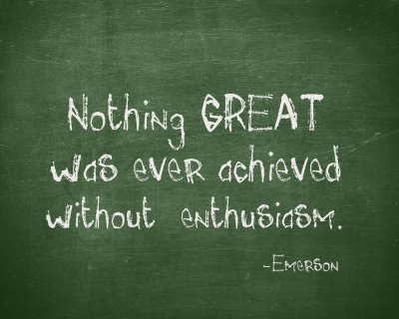
Core Action Value #10
Enthusiasm

Slide 85
Ralph Waldo Emerson said “nothing great was ever achieved without enthusiasm” and that is a law of the universe! It applies to organizations, and it also applies to families and to your personal life.

Slide 86
“Enthusiasm has power! When that power is released to support definiteness of purpose and is constantly renewed by faith, it becomes an irresistible power for which poverty and temporary defeat are no match. And it is a power which can be touched off in the mind of another person… Perhaps that is the greatest service anyone can render another, for enthusiasm is a contagious force.”
Napoleon Hill: The Science of Success

Slide 87
Cornerstone #1
Attitude
Positive attitudes create self-fulfilling expectations for success and happiness; negative attitudes create self-fulfilling expectations of failure and misery.

Slide 88
Cornerstone #2
Energy
Energy is life, and more than many of us will admit, whether or not we have energy is a decision we make with regard to how we commit our time, and not a physical state of being.

Slide 89
Cornerstone #3
Curiosity
Enthusiastic people are curious, and their quest for knowledge and understanding helps to fuel their vision for the future; one of the best ways to is to ask more and better questions (especially to ask more and better dumb questions).

Slide 90
Cornerstone #4
Humor
It’s true that humor is good medicine, but people with a sense of humor are also happier and more successful. Fortunately, you can cultivate a funny bone.

Slide 91
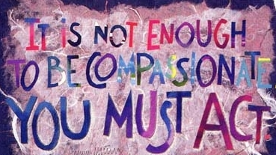
Core Action Value #11
Service

Slide 92
Whatever you most need in life, the best way for you to get it is to help someone else get it who needs it even more than you do.

Slide 93
“Each of us will define and measure success differently. Some will place more emphasis on the economic scorecard than others. No matter what your choice, if you are to succeed, you must understand that your rewards in life will be in direct proportion to the contribution you make.”
David McNally: Even Eagles Need a Push

Slide 94
Cornerstone #1
Helpfulness
It’s important that you reach out to help others, but even more important is the spirit in which you provide that help.

Slide 95
Cornerstone #2
Charity
It is a good thing to donate money to worthwhile causes, and even better to donate your time and energy.

Slide 96
Cornerstone #3
Compassion
Look beneath external appearances and circumstances to perceive the reality of the human being beneath those superficialities.

Slide 97
Cornerstone #4
Renewal
Take care of yourself and ask for help when you need it, because you cannot pour out of an empty pitcher.

Slide 98
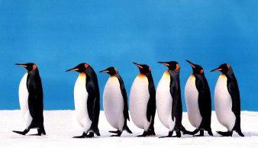
Core Action Value #12
Leadership

Slide 99
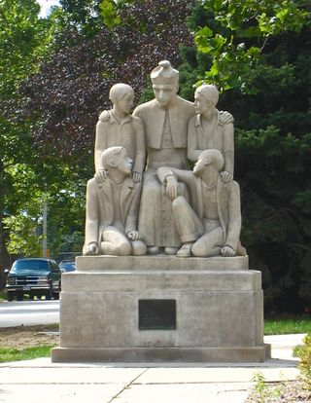
Don’t people who live their values inspire and influence others?
Core Action Value #12 is Leadership

Slide 100
Management is a job description; leadership is a life decision. In today’s complex world, we need leadership in every corner, not just in the corner office.

Slide 101
“Whatever your role in life may be, you make a difference. There is a 100 percent chance that you can be a role model for leadership. There is a 100 percent chance that you can influence someone else’s performance. There is a 100 percent chance that you can affect what someone else thinks, says, and does. There is a 100 percent chance that you will make a difference in other people’s lives.”
James Kouzes and Barry Posner: A Leader’s Legacy

Slide 102
Cornerstone #1
Expectations
A leader is someone who takes you to a different and better place, and by definition that means having high expectations of self and others.

Slide 103
Cornerstone #2
Example
To assume a leadership responsibility is to give up many freedoms, because leaders speak more forcefully by who they are than by what they say.

Slide 104
Cornerstone #3
Encouragement
An important duty of leadership is to create an environment where people work together with a spirit of pride, collegiality, and friendship.

Slide 105
Cornerstone #4
Celebration
Leaders foster teamwork, community, and a spirit of fellowship by celebrating personal and group achievements – and good faith failures.

